Slide 1
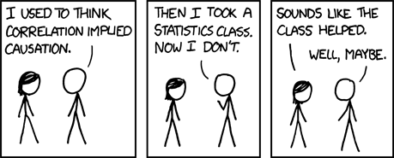

Slide 2
Read, analyse and discuss
With each article, read and assess the methodology (what is good/what is dodgy?), ethics, generalizability and impact
Make notes of other points of interest
Share your article with others in your group

Slide 3
Larger discussion
What differences did you note between the different studies? How would you categorize them (old/new)?
What values do you see/are revealed through the passage of time and cultural change?
If you were to research the same concepts under investigation in the ‘Robber’s Cave’ and in the ‘Beauty Becomes a Social Problem’ studies, how would you go about it?

Slide 4
Statistics!!!
The meanest part of AP Psychology

Slide 7
Qualitative
Quantitative
People are seen as individuals and this method allows researchers to gather subjective experiences of an event.
This can provide a unique insider view of the research question
This approach is less structured than a quantitative approach so unexpected results and insights can occur.
It’s concise, accurate and can be strictly controlled to ensure that the results are replicable and causation is demonstrated.
Quantitative data also has predictive power -- research can be generalised
It can also be a lot faster and easier to analyse than qualitative data.

Slide 8
Qualitative research gathers information that is not in numerical form
diary entries, open-ended responses, unstructured interviews and unstructured observations).
Qualitative data is typically descriptive data and is harder to analyze than quantitative data.
Quantitative data is in numerical form which can be put into categories, or in rank order, or calculated in units of measurement.
Quantitative data limits participant responses but is easier to measure and calculate

Slide 9
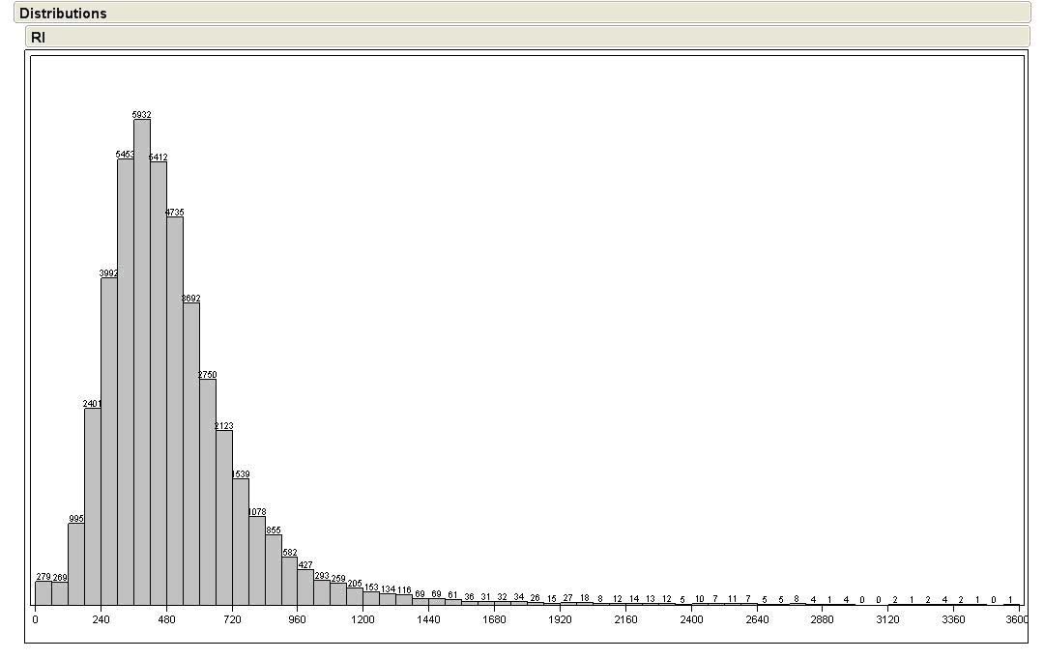
Descriptive Statistics
Descriptive Statistics has the goal of summarizing data to communicate with it…to make it meaningful and comprehensible
Organizes data meaningfully
Includes calculating central tendencies and measures of variation

Slide 10
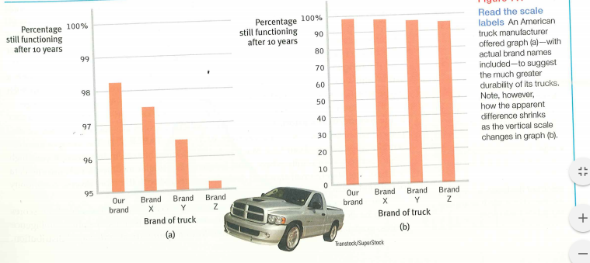
Histograms (bar graphs) are used to represent data but you need to be a careful consumer!

Slide 11
Dealing with Data: Central Tendency
Central Tendency is a way of capturing scores that are representative of a set of scores (distribution)
Mean
Median
Mode

Slide 12
Central Tendency: The Mean
What most people mean by “average”
Sum of a set of numbers divided by the number of numbers in the set

Slide 13
Central Tendency: The Mean
We denote the mean as

Slide 14
Central Tendency: The Mean
so if
then
n = the number of numbers in X (in this case 10)
Keep in mind that X is a set of numbers and n is a single number

Slide 15
Central Tendency: The Median
The median is the middle point in a distribution; it separates the distribution into two equal halves
if X = [1,2,4,6,9,10,12,14,17]
then 9 is the median
if X = [1,2,4,6,9,10,11,12,14,17]
then 9.5 is the median; i.e., (9+10)/2
There are ways of dealing with repeated numbers in the centre of the distribution; e.g., if X = [1,2,4,6,9,10,10,10,10,11,12,14,17]

Slide 16
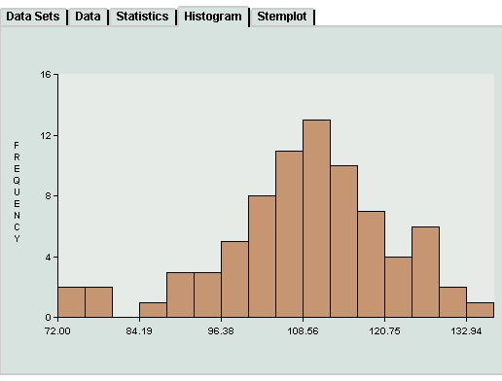
Central Tendency: The Mode
The mode is the most frequently occurring score in a distribution
if X = [1,2,4,6,6,6,8,10,12,14,17]
then 6 is the mode
Distributions can be multi-modal
Two bimodal distributions

Slide 17
Skewed data
Be aware of outliers – those extreme scores which skew (distort) the data set!
Skewed data is asymmetrical and influences which measure of central tendency should be used

Slide 18
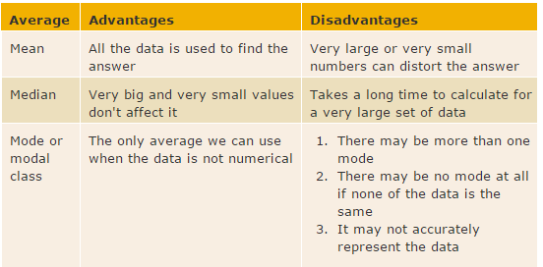
How do you decide what you need?
If your data set is skewed you do NOT want the mean, you want the median (could use mode but not as common)

Slide 19
Riley’s bad habits
Riley had many projects (all out of 100) and while he was in many ways a fine student, he was disorganized and would lose assignments. This meant that he had zeros when he otherwise would have a good score.
His teacher was tasked with reporting on his grades and discussing his progress with his parents. She is perplexed as to what would be the best way to describe his progress – help her!

Slide 20
Riley’s scores:
90, 95, 0, 83, 89, 0, 95, 0, 89, 0, 95
What should his teacher use: the mean, the mode, or the median?
Mean: 57.82 Median: 89 Mode: 0
0, 0, 0, 0, 83, 89, 89, 90, 95, 95, 95

Slide 21
Measures of variance: Range
It is important to know how much variation there is in the data (how similar or diverse the scores are)
A mean from scores with low variability are more reliable than a mean from scores with high variability
The range is the difference between the highest and the lowest score…easily calculated but not as informative as other measures

Slide 22
Measures of variance: Standard Deviation
This is essentially a measure of how much scores vary around the mean
The amount of variability impacts our ability to generalize from the data
If there is little variation in the data then the averages are more reliable
If the scores vary widely, then the averages are less reliable

Slide 23
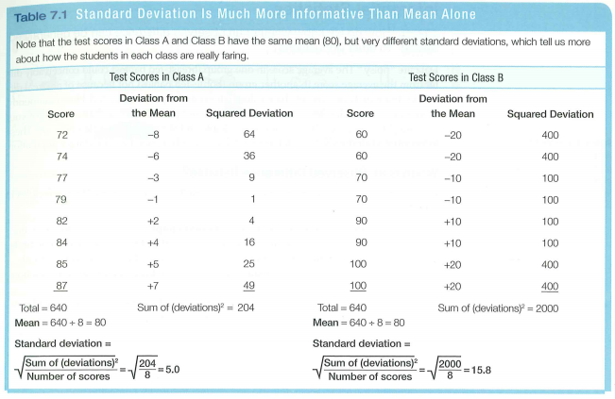
Standard Deviation

Slide 24
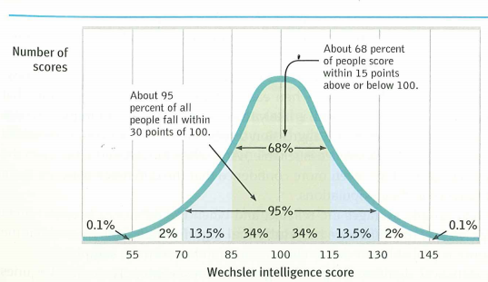
Normal curve

Slide 25
Inferential Statistics
With Inferential statistics we are trying to reach conclusions that go beyond the immediate data (we are inferring) – we infer the probability of something being true for a population from a the sample data
Hence why
Representative samples are better than biased samples
Less variable observations are more reliable than those that are more variable
More cases are better than fewer

Slide 27
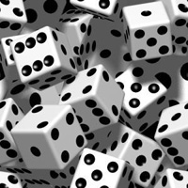
Significance
Statistical significance
The likelihood that a result or relationship is caused by something other than mere random chance
We accept odds of 5 out of 100 that an observed result is due to chance as the standard (less than 5% chance)

Slide 28
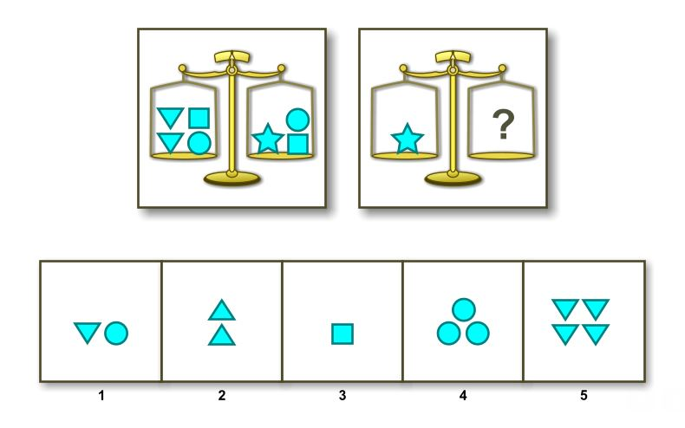
Hypothesis: Birth order affects intelligence scores, specifically older siblings score higher than younger siblings
We give the WISC to 100 randomly selected pairs of siblings

Slide 29
Statistical significance is not the same thing as importance
If, in 5 or more of the 100 pairs the younger siblings score as high or higher than the older, we reject the hypothesis as false
If, on the other hand, in 2 or more of the 100 pairs of siblings, the younger sibling scored as high or higher than the older sibling then that would be significant
(this is where the older siblings scored higher than the younger siblings 98 times out of 100)

Slide 30
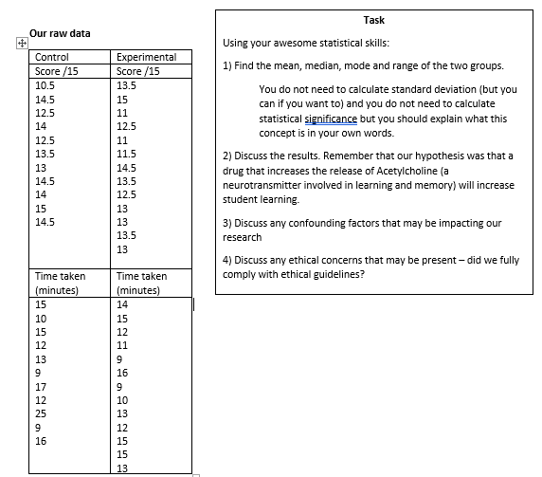
Let’s go back to our ACh study to practice!!!

Slide 31
A test is more than meets the eye

Slide 32
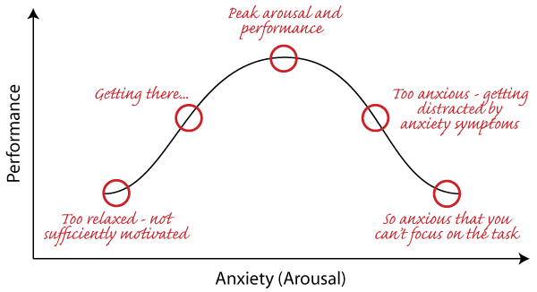

Slide 33
An experiment to remember…
Victor Benassi gave his college psyc students frequent in-class quizzes.
Some had questions and answers (review) while others required students to produce the answers (self-testing)
Weeks later on the final exam, the students did much better on the material that was self-testing (75% correct) rather than mere review (51% correct)

