Slide 1
The Structure of Canada’s Government
The Results are in

Slide 2
STV results
Liberal party won a seat
Green party won a seat
It took two rounds of elimination and Liberals reached the threshold (10 votes) right away Greens after the votes were redistributed

Slide 3
Your governing party (STV)

Slide 4
Your Official Opposition

Slide 5
Official Opposition via STV

Slide 6
In our House of Commons
We should have 16 Liberal MPS
We should have 5 Conservatives
We should have 4 Greens
We should have 4 NDP

Slide 7
Federal System
In the Federal system
Provincial governments (regional governments) are organized such that they can govern their residents with an eye on their needs while a central government focuses on the needs of a nation
Most responsibilities are divided between though there is some overlap (for example health care and justice)
There are inefficiencies where there are competing interests or where responsibilities overlap

Slide 8
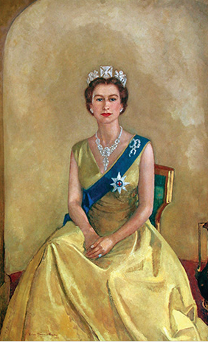
Canada is a Constitutional Monarchy
Queen Elizabeth II is the head of state
The Queen’s representative in Canada is the Governor General
The Queen appoints the Governor General on advice from the Prime Minister
The Crown heads all three branches of government:
Executive
Legislative
Judiciary

Slide 9
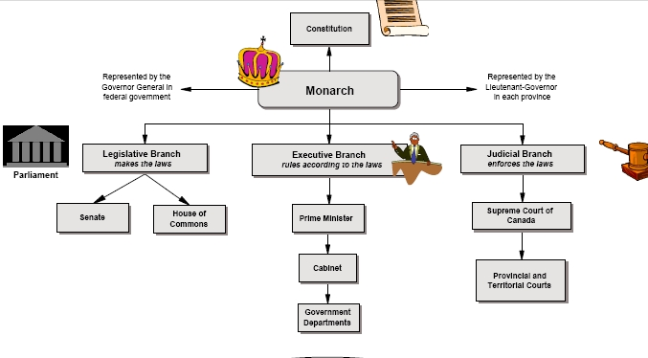
Three Branches

Slide 10
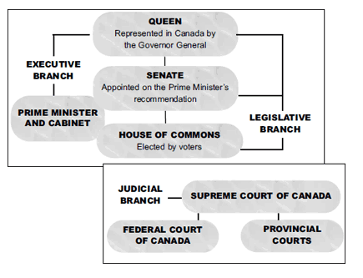
Three Branches of Government
Executive
Is responsible for administering and enforcing laws
Legislative
Is responsible for making, altering and repealing laws
Judiciary
Is responsible for resolving disputes according to law

Slide 11
Legislative Branch: Crafters of Laws
The Monarch (represented by the Governor General)
The Governor General usually serves five years
The GG acts on the advice of the PM and Cabinet
Importantly, the GG ensures that Canada always has a Prime Minister
If no party had a clear majority after an election, or if the Prime Minister were to die in office, the Governor General would have to choose a successor
House of Commons
Senate

Slide 12
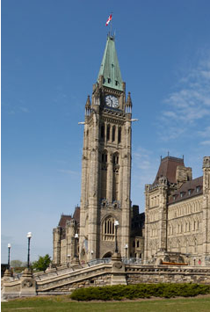
Legislative Branch
The Governor General
House of Commons
Has elected members (Members of Parliament a.k.a. MPs)
Number of MPs in Parliament depends on population (currently 338)
Where MPs represent constituents' views, discuss national issues and call on the government to explain its actions
Bills are debated and voted on
Senate

Slide 13
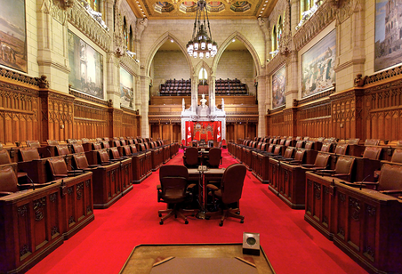
Legislative Branch
The Governor General
House of Commons
Senate
The Senate studies, amends (changes) and either rejects or approves bills passed by the House of Commons
No bill can become law until it has been passed by the Senate
Senators are appointed by the Governor General on the recommendation of the Prime Minister and hold office until age 75

Slide 14
Executive Branch: Implementers of laws
The monarch (represented by the Governor General)
The Prime Minister
An MP who is also the leader of the political party that is in power (majority or minority government)
The Cabinet

Slide 15
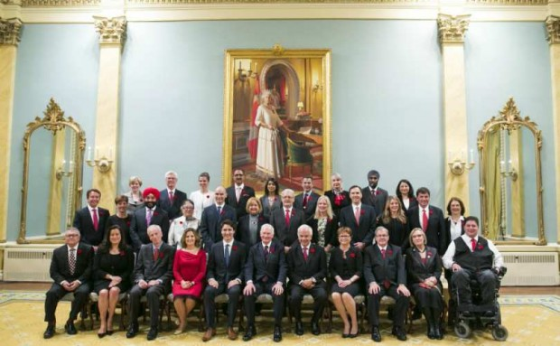
Executive Branch
The Cabinet
A small group of MPs selected from within the ruling political party
Ministers have responsibility for government policy and each Minister has a particular department for which that they are responsible

Slide 16
Welcome to Parliament
You won your seat and need to know a few things about the culture and responsibilities here…
Party Solidarity – the practice of party discipline means that members of the same party vote together in Parliament.
Cabinet Solidarity - Cabinet members must not show disagreement with government policies
Party Whip – An MP given the specific job ensuring all members of their party are present to support party interests
Speaker of the House – gets elected by fellow MPs. Their duty is to rule over the House and have the government answer questions during the question period. It is their job to keep decorum within the House.

Slide 17
Select someone for Key Cabinet Positions
Minister of Finance
Minister of Foreign Affairs
Attorney General of Canada
Minister of Health
Minister of Justice - Attorney General of Canada
Minister of Crown-Indigenous Relations and Northern Affairs
Minister of Innovation, Science and Economic Development

Slide 18
Welcome to Parliament
It is time to divvy up jobs and the Prime Minister selects MPs to be in Cabinet
The leader of the Official Opposition selects a Shadow Cabinet
If you didn’t make it into Cabinet, then you remain a backbencher
Sorry, only private member bills for you
The Prime Minister is likely thinking about patronage appointments that will need to be made

Slide 20
Meeting as a caucus
All three major parties meet separately every Wednesday morning,
Conservatives and Liberals gather their MPs and senators together to discuss policy and strategy.
The NDP has no senators, so its MPs make up the entire caucus

Slide 21
The Bill Before it is a Bill
First - Cabinet minister has idea and shares it with the Cabinet.
Second- If it is approved by Cabinet then lawyers put the idea into legal language.
Third - the bill gets examined by a Cabinet committee before the bill gets introduced to the party caucus.
Fourth - Caucus discusses the bill in the privacy of a caucus meeting, if approved by caucus it moves on to the House of Commons.

Slide 22
First Reading – Read in Parliament for the first time. There is no debate or voting.
Second Reading – MPs debate the spirit (essence) of the bill. It is voted on and sent to a Parliamentary committee.

Slide 23
Committee Stage: A committee hears witnesses, examines the bill clause by clause and submits a report recommending the bill be accepted as is or with amendments, or that it not proceed any further.
Report Stage: Committee members report back to the House and the House reviews the amendments.
Third Reading: The bill is debated a final time and voted on.

Slide 24
Once passed, the bill is sent to the other House (Senate), where the process starts again from first reading.
Royal Assent: The Governor General or a deputy gives the bill Royal Assent and the bill becomes law and takes immediate effect.

